Slide 1


ACH in the Era of Faster Payments
June 2020

Slide 2
ACH is a significant portion of the current $97 trillion payment market in the U.S.
Sources: Nacha; The 2019 Federal Reserve Payments Study
Notes:
The US payments volume is massive.
Some may find it interesting to note that the two largest payment types as measured by the dollar volume to be:
#1, Automated Clearing House / ACH a 4 –decades old account to account, batch based system that operates only during the day, not on week end or banker holidays. Most of these ACH transactions take 1 to 3 days to transfer value, yet it is the backbone of our payments system. Card transactions rely on ACH
2 Checks… that curious little piece of paper that says “I am going to scribble some information on this piece of paper and that’s going to move money from my account to yours”. Value transfer takes days and is unpredictable. Checks rank high primarily because this is how large businesses and governments transfer money.
This is why the industry is ready for change….

Slide 3
And if you haven’t heard, ACH is growing.
Value has increased by more than $1 trillion every year for the last 5 years.
Source: Nacha

Slide 4
Same Day ACH is expanding very quickly as well.
In 2019, Same Day ACH moved 1 million payments a day with a daily total value of $1 billion.
Source: Nacha

Slide 5
CARES Act federal assistance is being provided through ACH.
1.7 billion federal payments were made via ACH in 2019, moving $5.8 trillion.
CARES Act payments in April-May 2020
Economic Impact Payments: 114 million payments totaling $197 billion through May 15
Unemployment benefits
Assistance to healthcare facilities
Assistance to colleges and universities; student assistance

Slide 6
One area where ACH has further growth potential is B2B transactions.
A lot of checks are still used for business-to business (B2B) payments. This represents an opportunity for ACH.
Sources: Visa CCE, RPMG Research, Mercator Advisory Group estimates

Slide 7
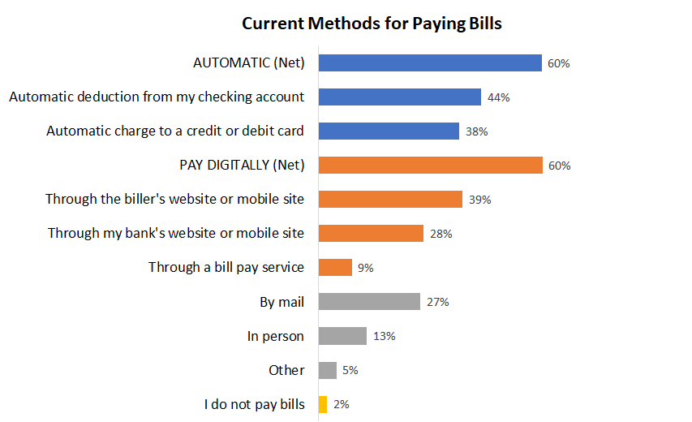
There is also opportunity in consumer bill pay.
While ACH already plays a significant role in consumer bill pay, many bills are still being paid by check and sent through the mail.
Source: Mercator Advisory Group North American PaymentsInsights series, 2019 Technology Survey, U.S.

Slide 8
ACH is a part of the faster payments environment.
Faster Payment Type | Messaging/Posting | Settlement | Availability | Level of Ubiquity | Credits | Debits | Limits
Same Day ACH | Within hours | < 10 hours | Business hours, Monday through Friday, less processing holidays | Any individual or business with a domestic bank account | Yes | Yes | $100,000
Early Warning's Zelle | "Within seconds" for transactions occurring between two integrated financial institutions | Next day. Moving to real time. | 24X7X365 | Any individual or business with a domestic bank account | Yes | No | Varies by financial institution
Debit Push Payments | With seconds to 30 minutes | End of day or next day | 24X7X365 | Any individual or business with a Mastercard or Visa branded card | Yes | No | $50,000
The Clearing House RTP | Within seconds | Real time | 24X7X365 | Any individual or business with a domestic bank account | Yes | No | $100,000
Source: Mercator Advisory Group

Slide 9
Some of the continued growth of ACH will come from Same Day ACH.
Same Day ACH offers ubiquity and efficiency in addition to transaction speed.
Real time?
ACH
Debit cards
Credit cards
Checks
Domestic wires
International
wires
Same Day ACH
Debit push payments
Relative low cost
Relative high cost
Source: Mercator Advisory Group

Slide 10
Consumers are not necessarily looking for instant payments.
U.S. consumer survey finds bill payers consider clearance within the same business day sufficient for some transactions.
Source: Mercator Advisory Group, North American PaymentsInsights Survey series, 2019 Technology Survey, U.S.

Slide 11
The current status of other forms of faster payments.
Person-to-person (P2P) payments are growing rapidly through
bank and fintech options.
Debit push payments are finding opportunities particularly with business-to-consumer (B2C) disbursements.
RTP is growing through the largest financial institutions in use cases for instant P2P and worker/gig economy payments.
FedNow is a work in progress.

Slide 12
Same Day ACH continues to evolve.
Higher per transaction limit
  $100,000 per transaction limit in place as of March 2020
  Use cases in B2B and B2C in particular
  Average dollar amount of an Same Day ACH payment increased by 40% from February to April in 2020
Added Same Day ACH Window
  The new window will allow Same Day ACH files to be submitted until 4:45 p.m. ET
  Same Day ACH processing window will go into effect on March 19, 2021
A 24x7x365 Network
  With more networks operating in an “always on” environment, the same is being discussed for ACH
  This is particularly relevant for Same Day ACH as other faster payments types also operate 24x7x365

Slide 13
New technologies are being launched for a modern network.
Afinis has launched application programming interfaces (APIs) for
account validation, ACH payment initiation, and transaction status.
Account Validation
ACH Payment Initiation
Transaction Status
The API provides improved timelines and automation for originators needing to validate the accuracy of account information before payment initiation.
The API provides improved automation for payment initiation and is applicable to nearly any instance where origination of an ACH transaction is needed in a standardized way.
The API provides transparent transaction tracking for payers. An originator of a transaction can check the status of payment instructions once they are submitted to a financial institution.
Retailer Product Lists Strategy
This slide is 100% editable. Adapt it to your needs and capture your audience's attention.

Slide 14
Q&A
Any Questions

